Slide 1

Analyzing & predicting customer churn in telecom industry using machine learning models
Prepared by:
Reeka Hazarika

Slide 2
Description:
Churn(which is loss of customers to competition) is a problem for telecom companies because it is expensive to acquire a new customer and companies want to retain their existing customers.
For a Telecom Company “X”, Churn is a problem for their business and churn rates have been increasing steadily over the last 1 year.
Company wants to predict the propensity of its customers to churn and this would help the company to determine the right engagement or intervention plan.
The Company wants to find out the factors influencing Customer Churn and to target the specific factors with offers more in-line with other service providers, which could help them to retain customers.

Slide 3
Objectives:
To predict Customer Churn.
Highlighting the main variables\factors influencing Customer Churn.
Use various ML algorithms to build prediction models, evaluate the accuracy and performance of these models.
Finding out the best model and providing final conclusion.

Slide 4
Model Building steps
Define Problem
Data Collection
Data Preparation
Perform Data Viz & Analysis
Variable Selection
Build Models
Validate & Measure Models Performance
Improve Models Performance
Execute Models for Prediction
Select the Best Fit Model

Slide 5
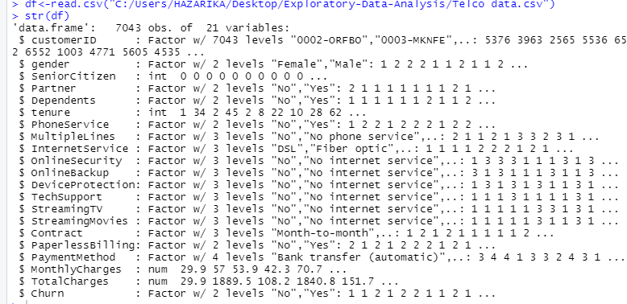
Data Source: https://github.com/jtsulliv/Machine-Learning/tree/master/churn-prediction.

Slide 6
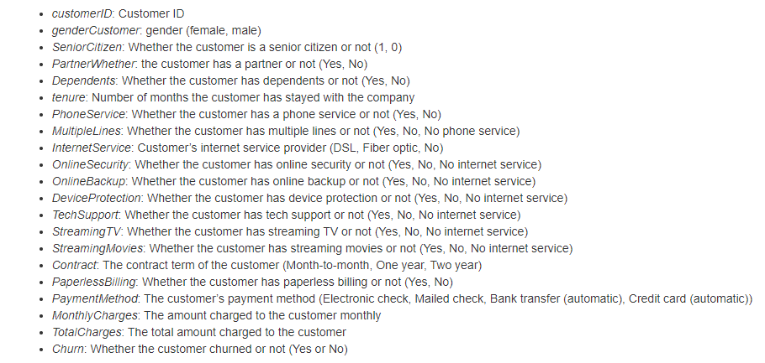
Description of the Variables:

Slide 7
Data Visualization &
Analysis

Slide 8
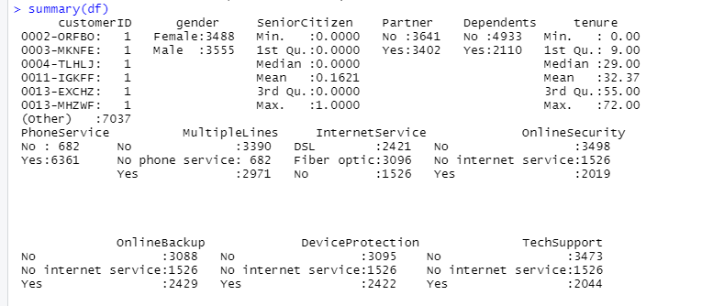
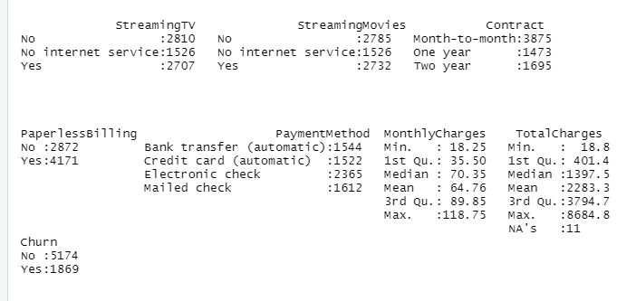
Summary statistics:

Slide 9
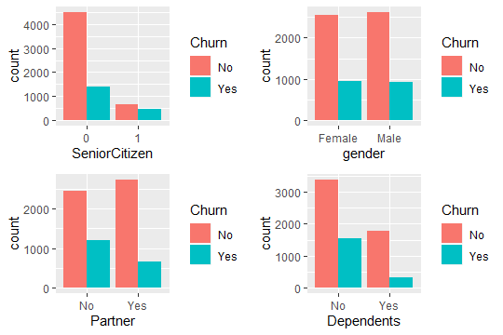
Visualizing statistics:

Slide 10
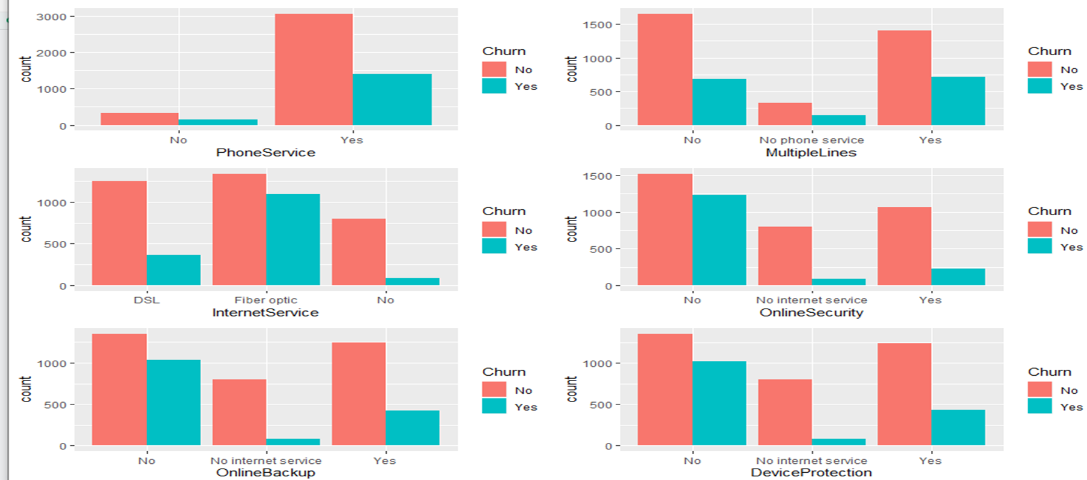

Slide 11
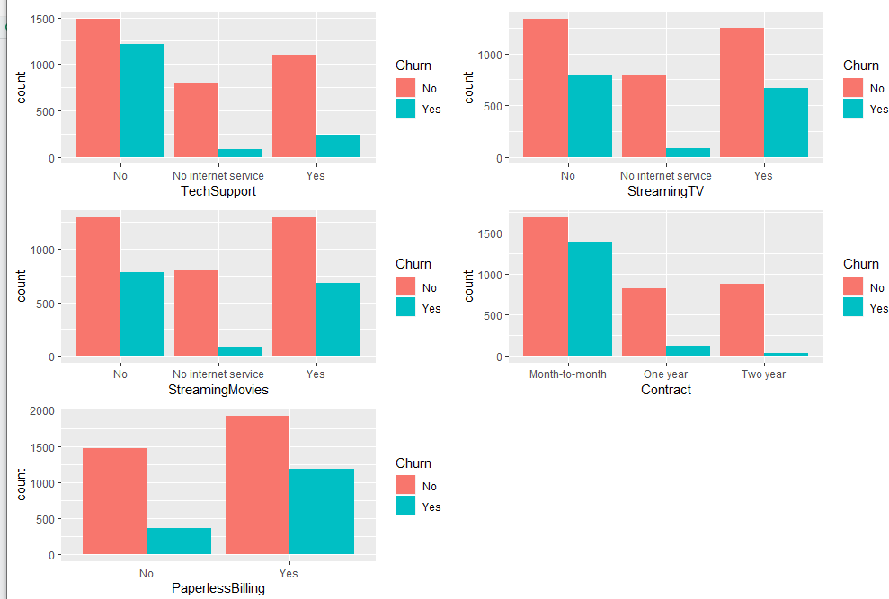

Slide 12
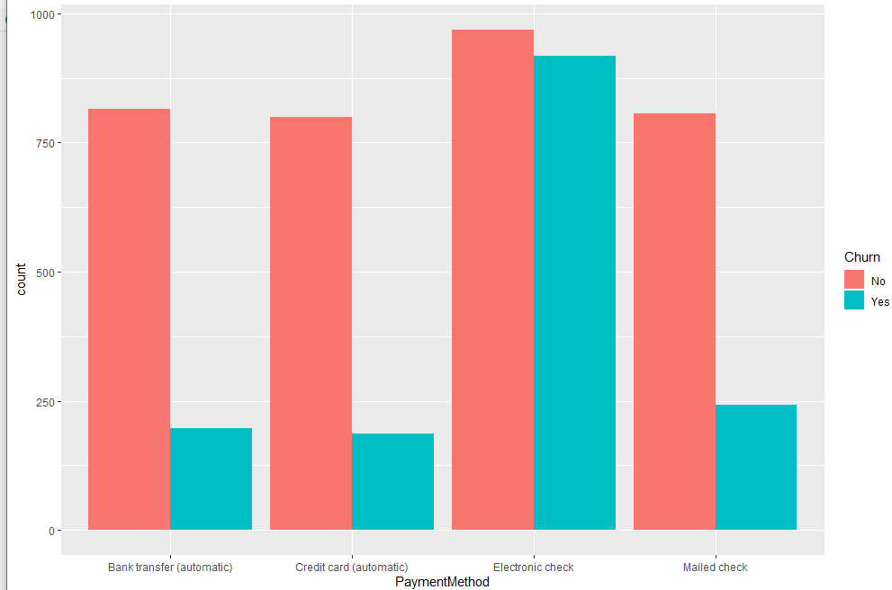

Slide 13

Average total Charges for Churn and Not Churn Customers

Slide 14
Main observations:
A lot of people with phone service churned.
People with fibre optic internet churned much more than people with DSL or no internet at all.
People without online backup, device protection, and online security churn fairly frequently.
Those without tech support tend to churn more frequently than those with tech support.
Those with Paperless Billing tend to churn more frequently than those without Paperless Billing.
Those with month-to-month contract tend to churn more frequently than those of one & two year contract.
Electronic check Payment method tend to churn more frequently than the other Payment method.
All of the categorical variables seem to have a reasonably broad distribution, therefore, all of them will be kept for the further analysis.

Slide 15
Building Predictive models using Anova , Logistic Regression, Decision Tree and Random Forest.

Slide 16
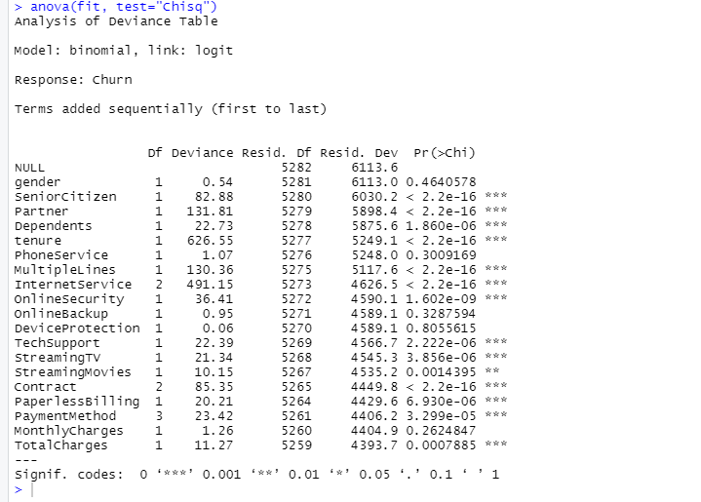
Anova (Chi-Square) test:
Analysing the deviance table we can see the drop in deviance when adding each variable one at a time.
Adding tenure, Internet Service, Contract and total Charges significantly reduces the residual deviance.

Slide 17

Model1: Logistic Regression
Splitting the data into a training set (75%), and test set (25%).

Slide 18
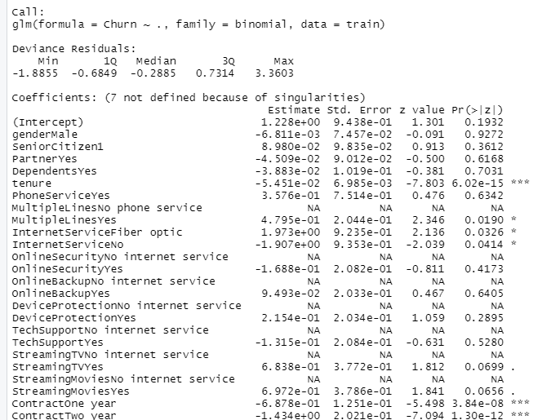
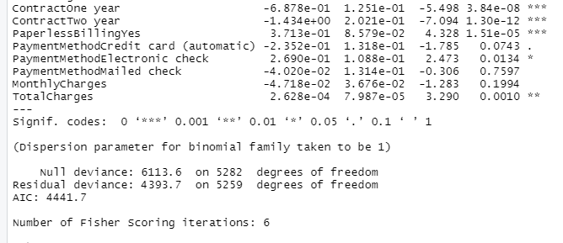
Model summary on all the variables as input:

Slide 19
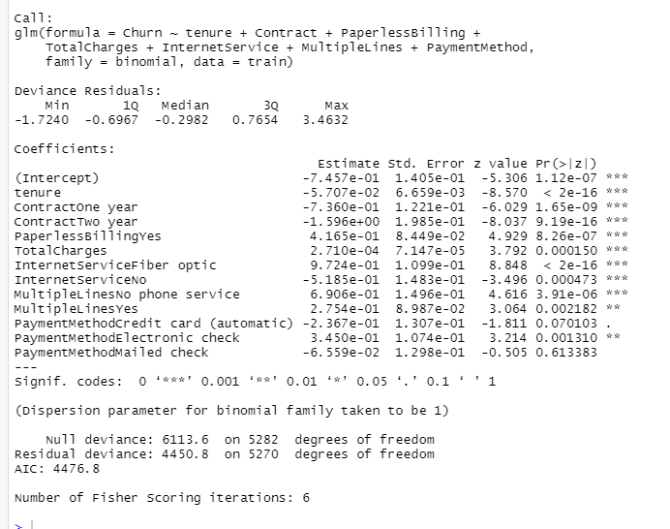
Model summary on statistically significant variables:

Slide 20
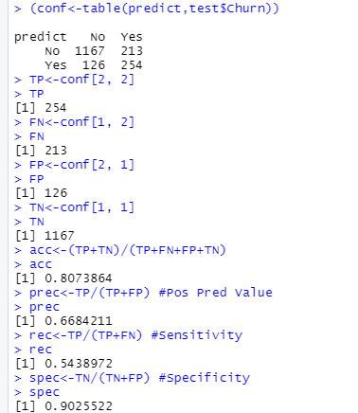
Model evaluation – confusion matrix:
True positives (TP): These are cases in which we predicted yes (they churned), and they did churn.TP=254
True negatives (TN): We predicted no, and they didn’t churn.TN=1167
False positives (FP): We predicted yes, but they didn’t actually churn. (Also known as a “Type I error.”).FP=126
False negatives (FN): We predicted no, but they actually churned. (Also known as a “Type II error.”) FN=213
The diagonal entries give our correct predictions, with the upper left being TN and the lower right being TP, the upper right gives the FN while the lower left gives the FP.

Slide 21
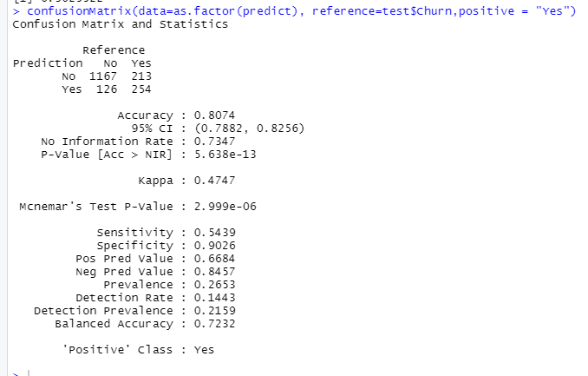
Model evaluation – confusion matrix (Package – Caret):

Slide 22
Observations – Logistic Regression model:
Tenure, Contract, Paperless Billing and Total charges are the significant variables and can be identified as the best predictors of Customer Churn.
AIC – 4441.7 (when all variables are taken as input) & AIC – 4476.8 (when only significant variables are taken as input). Hence AIC does not change much even if we use only the significant variables.
Model Accuracy – 80.7%
Sensitivity (true positive rate, recall) – 54.4% - the model has predicted 54.4% of customer that actually churned.
Specificity (true negative rate) – 90.3% - the model has predicted 90.3% of customer that are actually not churned.
Precision(Positive Prediction Value) – 66.8% prediction of churned customers is correct.

Slide 23
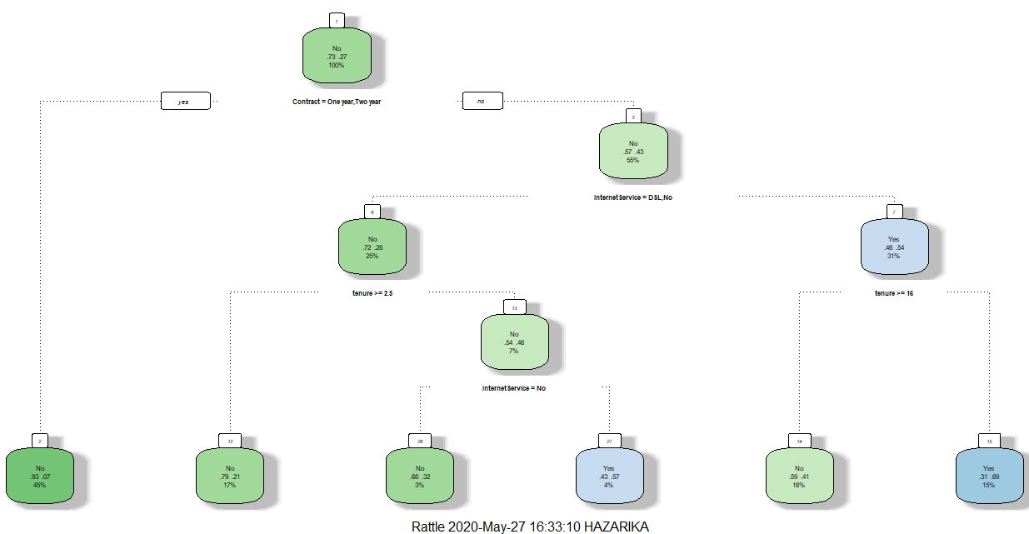
Model 2 – decision tree
Significant Variables are taken for plotting Decision Tree

Slide 24
Interpretation of decision tree
The contract variable is the most important. Customers with month-to-month contracts are more likely to churn.
Customers with DSL internet service are less likely to churn.
Customers who have stayed longer than 15 months are less likely to churn.
Customers without internet service are more likely to churn.

Slide 25
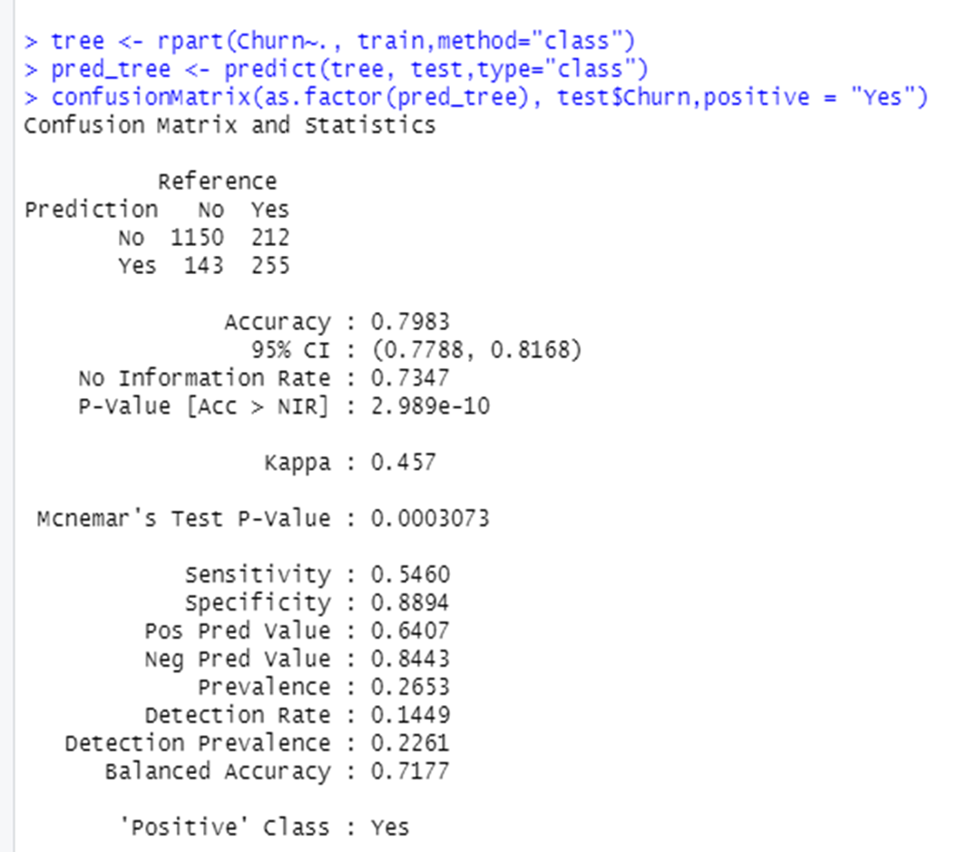
Model evaluation – Decision Tree Confusion Matrix

Slide 26
Observations – Decision Tree Model
Model Accuracy – 79.8%~80%
Sensitivity (true positive rate, recall) – 54.6% - the model has predicted 54.6% of customer that actually churned.
Specificity (true negative rate) – 88.9% - the model has predicted 88.9% of customer that are not churned.
Precision(Positive Prediction Value) – 64.07% prediction of churned customers is correct.
The Logistic Regression model is slightly better than the Decision Tree with an accuracy of 80.7%.

Slide 27
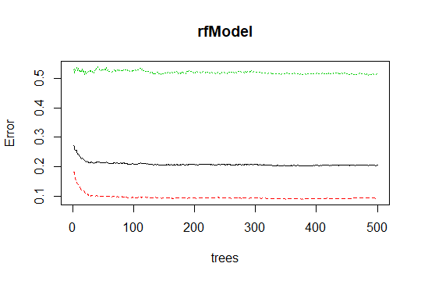
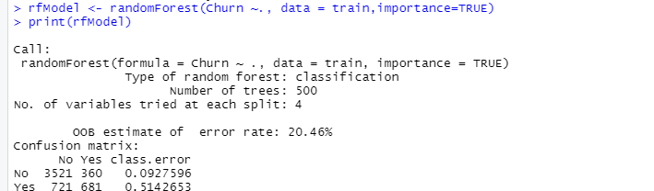
Model 3 - Random Forest
The black line represents the entire sample, the red line represents the error rate for Prediction “No” (not churned) and the green line represents the error rate for Prediction “Yes” (churned).
The overall error rate is around 20%.
As the number of trees increases, the error rate decreases, and then becomes almost constant after about 100 trees.

Slide 28
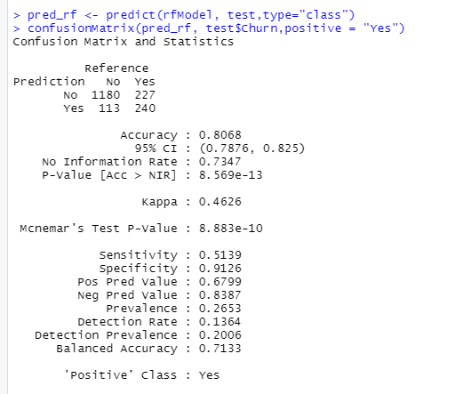
Model evaluation – random forest Confusion Matrix

Slide 29
Observations – random forest Model
Model Accuracy – 80.68%~80.7%
Sensitivity (true positive rate, recall) – 51.4% - the model has predicted 51.4 % of customer that actually churned.
Specificity (true negative rate) – 91.3% - the model has predicted 91.3 % of customer that are actually not churned.
Precision(Positive Prediction Value) – 67.99%~68% prediction of churned customers is correct.
The Logistic Regression model is almost equal as Random Forest Model with an accuracy of 80.74%.

Slide 30
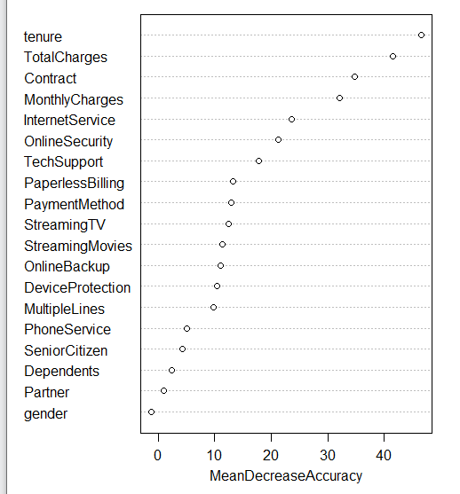
varImpPlot
Similar to the Logistic Regression and Decision tree, the Random Forest model has identified Tenure ,Contract and Total Charges as important predictors for churn.
Internet service, Paperless Billing and Payment Method does not appear as important in this model, and Monthly Charges variable is now highly emphasized.

Slide 31
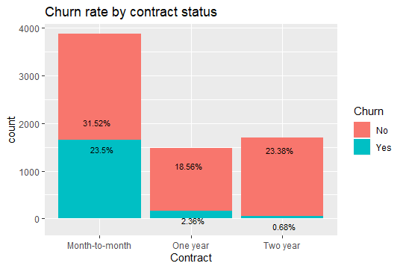
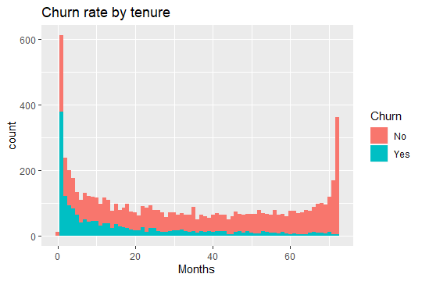
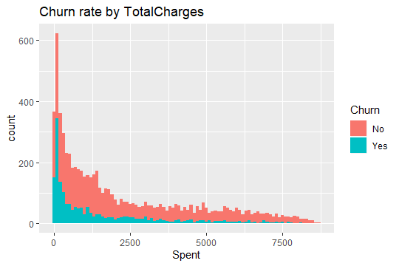
Data visualization based on models churn predictors: contract, tenure, and total charges
The length of time of the customer decreases the likelihood of churn. There is a large spike at 1 month, indicating that there are a large portion of customers that will leave after just one month of service.
The churn rate of month-to-month contract customers is much higher than the longer contract customers.
Customers who have spent more with the company tend not to leave.

Slide 32
Summary:
In terms of accuracy the Logistic Regression model is slightly better than the Decision Tree Model and almost equal as Random Forest Model.
Precision rate (percentage of correct prediction of churned customers) for Random Forest model (68%) is slightly better than Logistic Regression (66.8%).
Random Forest model is the best fit model.

Slide 33



Customers with month-to-month contracts.
Customers without internet services and with fibre optic internet services.
Customers without online backup, device protection, online security and tech support.
Customers with Paperless Billing and Electronic Check Payment method.
Customers who have been with the company for a longer period.
Average Total Charges for Not Churned customers is approx. 2553 AED and that of Churned Customers is approx. 1532 AED.
Customers with DSL Internet Services.
Customers with multiple lines.
Expected
to
Churn
Expected
to Not Churn

